Slide 1

r
Department of Computer Applications
Robust Data-Driven Analysis for Electricity Theft
Attack-Resilient Power Grid
׀
Review - ׀׀׀
Presentation By:
Govardhan Reddicharla
Roll No: 23691f0049
Under The Guidance of:
Dr.Srinivasan J
Assistant Professor
Department of Computer Applications

Slide 2
CONTENTS
Abstract
Technologies and Tools Used
Modules Description
Testing
Experimental Results
Performance Evaluation
Comparison with the Existing System
Code Snippets
Screenshots of Implementation
Conclusion
Scope for Future Enhancement

Slide 3
ABSTRACT
Problem statement:
Electricity theft in smart grids poses a major challenge due to data imbalance, anomalies, and evolving fraud techniques. Existing systems often fail to detect such thefts accurately, leading to operational and financial losses.
Project objectives:
To develop a robust machine learning framework that accurately detects electricity theft from smart meter data. The goal is to enhance detection accuracy, reduce false positives, and support real-time insights via a dashboard.
Brief solution approach:
The system applies preprocessing, feature selection, and SMOTE to handle imbalanced data, followed by model training using Decision Tree, Random Forest, SVM, XGBoost, ANN. A Flask-based dashboard visualizes predictions for real-time monitoring.

Slide 4
TECHNOLOGIES AND TOOLS
Programming Language: Python 3.11
Machine Learning Models: Decision Tree, Random Forest, Support Vector Machine (SVM), XGBoost, Artificial Neural Network (ANN)
Data Balancing Technique: SMOTE (Synthetic Minority Over-sampling Technique)
Web Framework (Dashboard): Flask (Python Micro Web Framework)
Feature Selection / Extraction: Filter-based and embedded methods (based on feature importance from tree-based models)
TOOLS USED
Editors: Visual Studio Code
Libraries: Scikit-learn, XGBoost ,TensorFlow/Keras , Imbalanced-learn , Pandas, NumPy , Matplotlib, Seaborn
Hardware: Intel Core i5/i7, 8 GB RAM, SSD storage

Slide 5
MODULES DESCRIPTION
Data Collection & Input Module:
Collects smart meter electricity consumption data from customers.
Handles raw data ingestion (CSV, database, or simulated).
Validates structure and handles missing input records.
Preprocessing Module:
Cleanses the data by removing anomalies, filling missing values.
Applies SMOTE to handle class imbalance (theft vs. normal).
Normalizes and scales data for better ML performance.
Feature Selection & Extraction Module:
Identifies important features using statistical methods and model-based rankings.
Reduces dimensionality to improve model accuracy and training speed.
Prepares the dataset for input to machine learning algorithms.

Slide 6
MODULES DESCRIPTION
Model Training & Prediction Module:
Trains various ML classifiers (Decision Tree, Random Forest, SVM, ANN, XGBoost).
Evaluates models using metrics like Accuracy, Recall, and F1-score.
Predicts whether electricity usage is normal or fraudulent.
Visualization & Dashboard Module:
Built using Flask web framework.
Displays prediction results, alerts for theft detection, and performance metrics.
Allows admin users to view usage data, track theft events, and monitor model output.

Slide 7
TESTING
Unit Testing:
Each core module—preprocessing, feature selection, model training, and dashboard—was independently validated to ensure correct internal functionality.
Integration Testing:
The flow from data ingestion to prediction and dashboard output was tested to confirm seamless interaction between connected modules.
System Testing:
The entire system was evaluated with realistic smart meter datasets to verify end-to-end functionality, robustness, and theft detection performance.
Validation Testing:
Model predictions were matched against actual theft labels using metrics like recall and accuracy to confirm reliable classification performance.
Performance Testing:
The system’s response time, resource usage, and throughput were tested using large datasets to ensure it can handle real-world data loads efficiently.
Regression Testing:
Each modification, such as model tuning or feature adjustments, was tested to ensure existing system performance and accuracy remained unaffected.

Slide 8
EXPERIMENTAL RESULTS
Metric | Result | Inference
Accuracy (XGBoost) | 83.08% | High reliability
Recall (XGBoost) | 0.87 | Strong ability to detect theft cases
F1-Score | 0.82 | Balanced performance between precision and recall
Precision | 0.77 | Good accuracy in identifying actual thefts
Training Time | Low | Fast model convergence with optimized features
Outcome:
Effectively detects electricity theft even in imbalanced datasets
High recall ensures minimal theft cases are missed
Balanced precision avoids over-alerting false thefts
Fast and scalable training pipeline using XGBoost and SMOTE

Slide 9
PERFORMANCE EVALUATION
Model | Accuracy | Recall | Precision | F1-Score | Training Time
XGBoost | 83.08% | 0.87 | 0.77 | 0.82 | Low
Random Forest | 84.67% | 0.85 | 0.75 | 0.81 | Medium
Decision Tree | 75.15% | 0.72 | 0.70 | 0.70 | Very Low
SVM | 62.25% | 0.60 | 0.57 | 0.59 | High
ANN | 53.37% | 0.52 | 0.50 | 0.50 | High

Slide 10
PERFORMANCE EVALUATION
SMOTE-based data balancing significantly improved theft case recall without affecting model generalization.
XGBoost and Random Forest provided high prediction accuracy with fast training and minimal overfitting.
Decision Tree, ANN, SVM models also performed well in predicting theft cases.
Evaluation metrics like accuracy, recall, precision, and F1-score confirmed stable and reliable classification performance.
The complete system, including the Flask-based dashboard, was tested for scalability, speed, and real-time performance, confirming its reliability and readiness for deployment in smart grid environments.

Slide 11
COMPARISON WITH THE EXISTING SYSTEM
Aspect | Existing System | Proposed System
Data Imbalance Handling | Not addressed or manually balanced | SMOTE used for effective synthetic minority oversampling.
Model Types Used | Basic ML models (e.g., DT or Naive Bayes) | Advanced ML models (XGBoost, RF, SVM, ANN) with feature tuning.
Feature Engineering | Limited or manual feature selection | Automated, model-based feature selection for better relevance.
Detection Accuracy | Moderate, with frequent false negatives | High accuracy and recall, especially with XGBoost.
Real-Time Visualization | Typically offline or absent | Flask-based interactive dashboard for real-time insights.
Scalability & Deployment | Not scalable, lacks modularity | Scalable, modular system suitable for smart grid environments.

Slide 12
CODE SNIPPETS
ml_model_training.py import pandas as pd
import numpy as np
import joblib
from sklearn.model_selection import train_test_split
from sklearn.preprocessing import StandardScaler
from sklearn.metrics import accuracy_score, classification_report
from sklearn.tree import DecisionTreeClassifier
from sklearn.ensemble import RandomForestClassifier
from sklearn.svm import SVC
import xgboost as xgb
from tensorflow import keras

Slide 13
CODE SNIPPETS
app.py import numpy as np
import pandas as pd
import joblib
import threading
from playsound import playsound
from flask import Flask, request, jsonify, render_template
# Load trained models
scaler = joblib.load("scaler.pkl")
rf_model = joblib.load("random_forest_model.pkl")
dt_model = joblib.load("decision_tree_model.pkl")
svm_model = joblib.load("svm_model.pkl")
xgb_model = joblib.load("xgboost_model.pkl")
ann_model = joblib.load("ann_model.pkl")

Slide 14
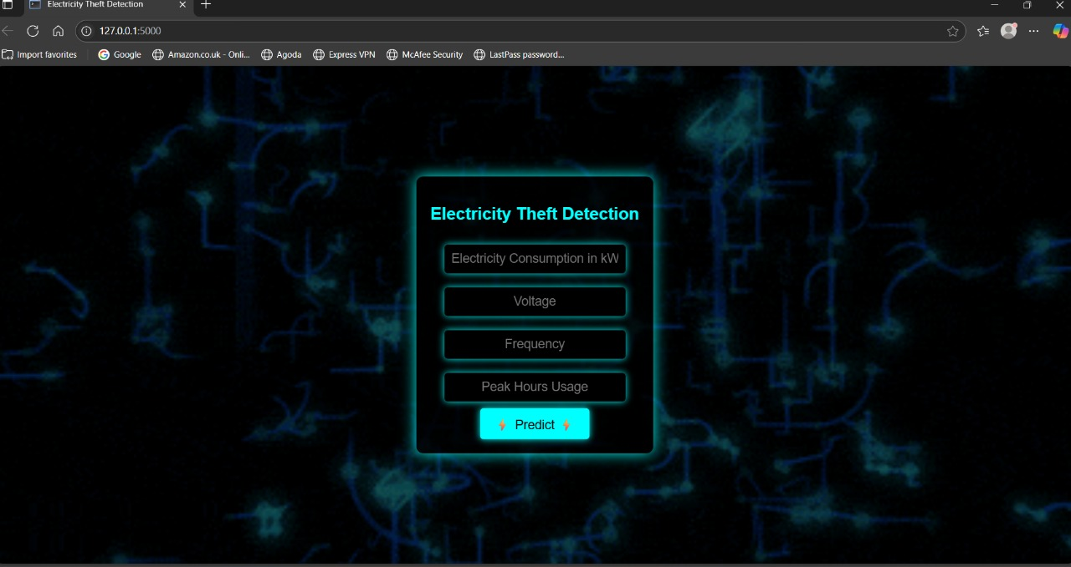
SCREENSHOTS OF IMPLEMENTATION

Slide 15
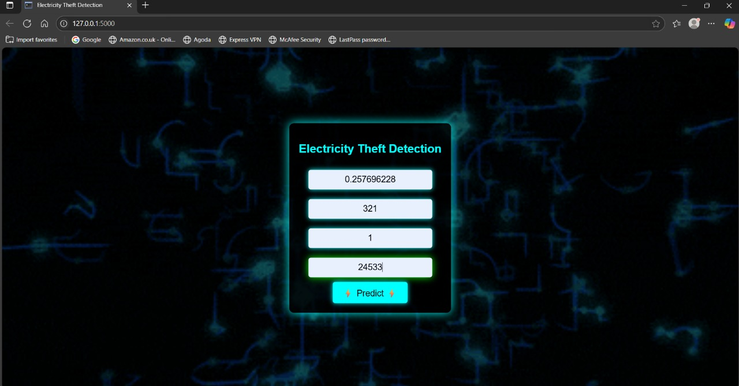
SCREENSHOTS OF IMPLEMENTATION

Slide 16
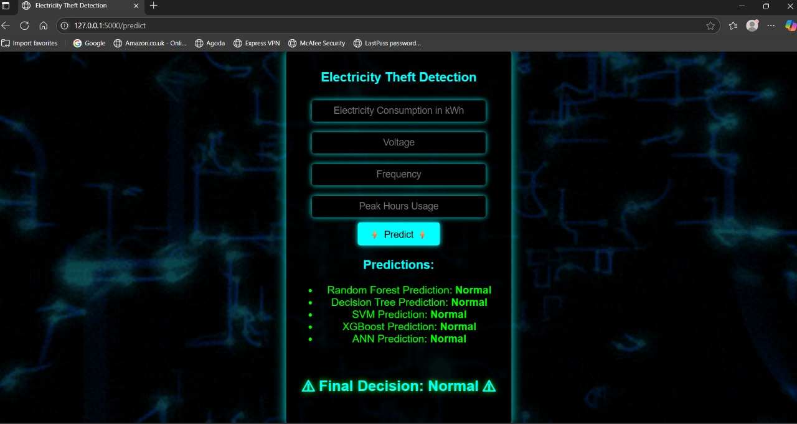
SCREENSHOTS OF IMPLEMENTATION

Slide 17
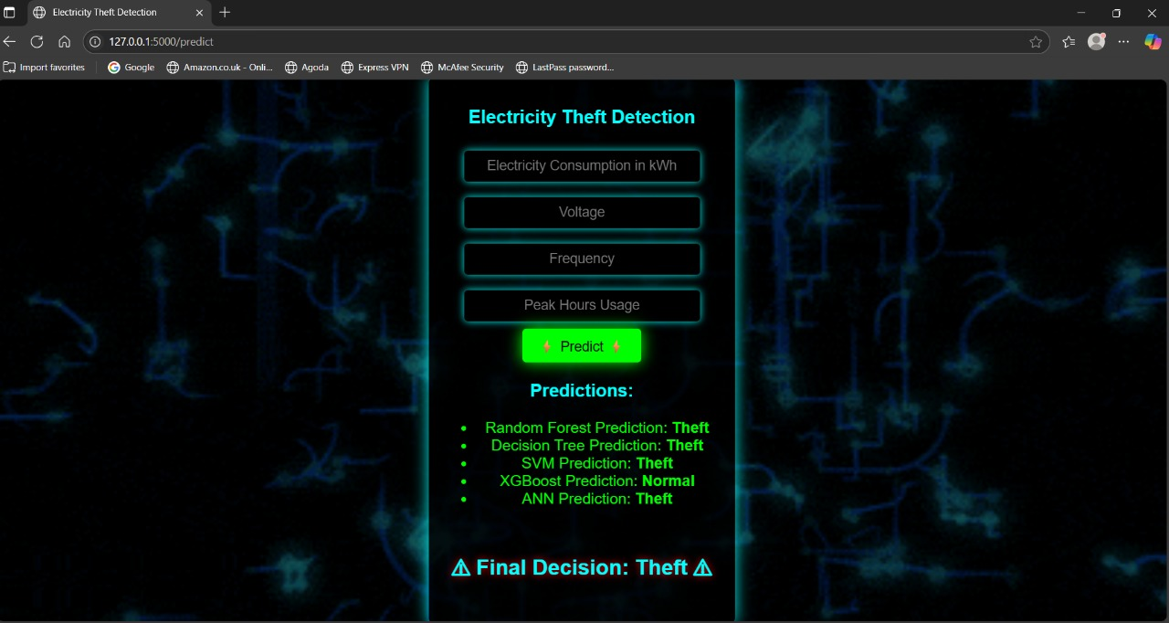
SCREENSHOTS OF IMPLEMENTATION

Slide 18
CONCLUSION
The proposed system effectively detects electricity theft using advanced machine learning models, with XGBoost delivering the highest accuracy and recall.
Data imbalance, a major challenge in theft detection, was successfully handled using SMOTE, improving the system’s ability to detect minority theft cases.
Preprocessing, feature selection, and model evaluation pipelines were carefully designed to ensure robustness, scalability, and high classification performance.
The Flask-based dashboard provides a real-time, user-friendly interface for administrators to monitor usage patterns and receive theft alerts.
Overall, the system demonstrates high accuracy, fast execution, and practical deployment capability for improving the resilience of modern smart grids.

Slide 19
SCOPE FOR FUTURE ENHANCEMENT
Real-Time Smart Meter Streaming Support:
The system can be extended to handle live streaming data from IoT-based smart meters, allowing real-time detection and alerting of fraudulent activities.
Geospatial and Customer Behavior Analysis:
Incorporating customer location data and historical behavioral patterns may improve detection accuracy and help identify regional theft trends.
Blockchain Integration for Data Security:
Blockchain can be used to securely log and validate electricity usage data, ensuring tamper-proof records and enhancing the transparency of the detection process.
Mobile-Based Admin Interface:
Developing a mobile-friendly dashboard or app can enable field operators and utility administrators to access theft alerts and reports on-the-go.

Slide 20

THANK YOU

